Slide 1

Does COVID have an effect on social media activities related to mental illness?
Anh Nguyen, Hanna Song

Slide 2
Research Question
Research question:
Does COVID affect post trends and post engagements from mental illness related subreddits?
Hypothesis:
Mental health-related subreddits exhibit a shift in post trends as well as the number of engagements based on post texts, number of comments and upvote ratios between periods pre-covid and post-covid
Problem of interest:
How COVID-19 affects people's mental health and social media behavior
Notes:
Reddit is a social news website and forum where content is socially curated and promoted by site members through voting

Slide 3
Key Constructs and
Their Relationships
Key Constructs:
COVID-19
Post trends
Number of engagements
Relationship: Causal
Constructs 1 causes construct 2, 3
COVID-19 has an impact on how the post trends (post length, topic modeling - future step) and number of engagements (number of comments, upvote ratio and score) change over time

Slide 4
Importance of Relationship
Understanding the impact of COVID-19 on mental health
Monitoring community well-being online
Informing public health intervention
Research and academic purposes
Further research on socio-economic circumstances, overall happiness index
Notes:
Does covid affect post trends from mental illness related subreddits?
Mental health-related subreddits exhibit a shift in post trends as well as the number of engagements based on post texts, number of comments and upvote ratios, between periods pre-covid, mid-covid, and post-covid

Slide 5
Overview:
Algorithms and Techniques
Python:
Data Scraping using Reddit API
Data Transformation: Post Length
Data Visualization: Descriptive Statistics
Data Analysis: Time Series Analysis
Power Analysis: ANOVA
ML Analysis (future): Topic modeling
Notes:
Does covid affect post trends from mental illness related subreddits?
Mental health-related subreddits exhibit a shift in post trends as well as the number of engagements based on post texts, number of comments and upvote ratios, between periods pre-covid, mid-covid, and post-covid

Slide 6
Description of Pilot Data
Collected monthly top posts from 9 mental health-related subreddits during the same time frames using Reddit API
Mental health-related subreddits:
Depression, anxiety, adhd, bipolar, ptsd, Schizophrenia, Eating Disorders, Brain Fog, SuicideWatch
2 time frames:
Pre-COVID: 2018 - January, 2020
Post-COVID: February, 2020 - 2022
Notes:
Schizophrenia

Slide 7
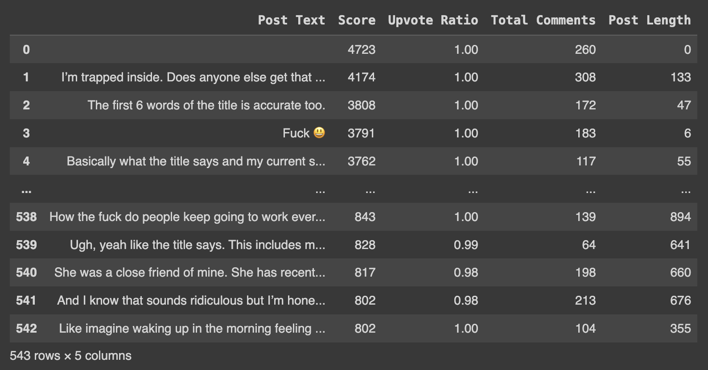
Description of Pilot Data
Each dataset contains:
Post Text
Score
Upvote Ratio
Total Comments
Added: Post Length
Sample Dataset from Depression Subreddit
Notes:
Schizophrenia

Slide 8
Unit of Analysis
Social media activities – posts
Monthly top posts from 9 different major subreddits on mental health
Features to be observed: post text, post length, number of comments, upvote ratio, Create on(Time)

Slide 9
Theoretical Population
All reddit posts on all mental health-related subreddits at any given time
We want to generalize reddit posts within mental health related subreddits
Notes:
All reddit users post/comment on mental health-related subreddits at any given time
We want to generalize reddit user’s behavior within mental health related subreddits

Slide 10
Accessible Population
Monthly top posts on mental illness related subreddits from two time intervals of 2018 - Jan, 2020 to Feb, 2020 - 2023
Subreddits: Depression, anxiety, adhd, bipolar, ptsd, Schizophrenia, Eating Disorders, Brain Fog, SuicideWatch
How to get access:
Use reddit API to collect data directly from the site as Reddit is a public website
Legal as long as we respect regulations such as the GDPR and the CCPA

Slide 11
Sampling Frame
Sampling frame:
Post engagement: total comments, score, and upvoted ratio
Post trends: post length (in the future: topic modelling)
Sample: top posts from 9 mental health related subreddits from two time frames
Level of replication: applying the same NLP classification process and Time series analysis on 9 subreddit dataset separately
find similarities on our subgroups

Slide 12
Sample Size
Sample size:
Monthly top posts on mental-health related subreddits from 2018 - 2022
Total 7077 data points
Sampling bias: only some specific mental health-related subreddits are scraped → not a representative of all reddit users with mental health disorders

Slide 13
Threats to the
External Validity
Units: Our sample might not be representative of the population since the data is restricted to specific random subreddits
Place: Data are collected from only one place - Reddit
Reddit has specific characteristics that allow people to be more straightforward and comfortable expressing their opinions/feelings. People truly get the pros of being anonymous on here
Time: Limited to 2 years before and after COVID, which may not be representative of all points in time

Slide 14
Sampling Strategy
Cluster Random Sampling
Collecting Reddit data in two time intervals (uniformly) from 9 different random mental health related subreddits and combine them together → Cluster
Using this combined sample as a representative of the population to draw a conclusion on the relationship between social media activities and COVID
Population: All Reddit activities regarding mental health at all points in time
Purposive Sampling: Intentionally scrape data from specific mental health subreddits

Slide 15
Measures for Constructs
Feature | Construct | Scale
Time (Created On) | COVID-19 | Interval
Post Length | Post Trends | Ratio
Total Comments | Post Engagement | Ratio
Upvote Ratio | Post Engagement | Ratio
Score | Post Engagement | Ratio
Notes:
These are the relevant features that we're going to analyze with regards to our constructs
Explanation:
Interval: one where there is order and the difference between two values is meaningful
Ratiothere is order and the difference between values matter in measurement, has an absolute zero

Slide 16
Feature Validity
Construct | Feature | Validity
COVID | Time (Created On) | Concurrent validity, Face validity Time is the feature that differentiate pre and post COVID
Post Trends | Post length | Concurrent validity, content validity, predictive validity, face validity Measure post length, and topic modeling (future step) Compare post length between pre and post COVID using ARIMA prediction time series
Post Engagement | Total comments, Upvoted ratio, Score | Convergent-discriminant validity, concurrent validity, predictive validity, face validity Measure quantitatively with comparing post engagement between pre and post COVID using ARIMA prediction time series
Notes:
concurrent validity - measure the same constructs with title and post and total comments and upvoted ratio

Slide 17
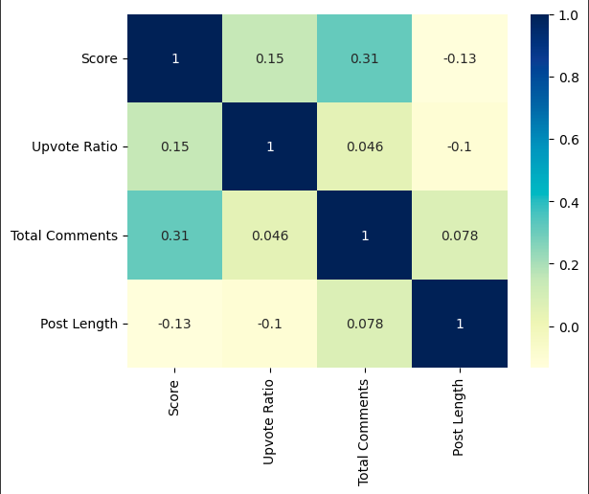
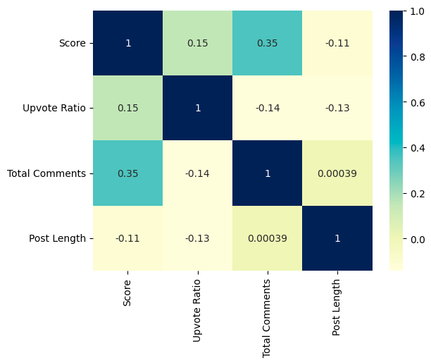
Convergent-Discriminant Validity
Pre-COVID
Post-COVID
Pearson's Correlation on Depression subreddit data with log transformation
Notes:
we use pearson’s correlation on the depression subreddit sample to study the relationship between variables and validate their convergence - discriminance as follows
upvote ratio - total comments; upvote ratio - score; total comments - score positively correlated both pre and post-covid, indicating convergent validity. however, post length and upvote ratio correlation is lower and negative which means ppl post longer than react

Slide 18
Quantification of Measurement Error
Construct | Feature | Measurement | Measurement Error
COVID | Time | Unique Value → collected by the site | Directly scraped from the site → reliable by itself
Post Content | Post Length | Using python library with characters of individual posts | Posts don’t include post text – Null → 9 subreddits available
Post Engagement | Upvote ratio, Total Comments, Score | Unique value → collected by the site | Reactions might vary from content likely to have upvote but less comments likely to have more comments but less upvote

Slide 19
Reliability of Measures
Feature | Reliability
Time (Created On) | Reliable by itself
Post Length | Conduct a reliability analysis by calculating inter-rater reliability with 9 different subreddit datasets
Upvote Ratio, Total Comments Score | Conduct a reliability analysis by calculating inter-rater reliability with 9 different subreddit datasets

Slide 20
Appropriate Measure
of Reliability
Construct | Feature | Measure of Reliability
COVID | Time | Internal Consistency Measure 9 different subreddits in same time frame
Post Content | Post Length | Internal Consistency Compare 9 subreddits post length to determine if all are relevant for reliability
Post Engagement | Total comments, Upvote ratio, Score | Internal Consistency Compare 9 subreddits total comments, upvote ratio, and score to determine if all are relevant for reliability
Notes:
inter-annotator agreement in sentiment labelin

Slide 21
Ruling Out
Alternative Explanations
Control for other external events
Consider changes in subreddit rules or moderation
Consider technological changes
Updates to the Reddit platform,
Changes in algorithms or new features
Control group or comparison analysis:
Selecting a similar set of subreddits that are not directly related to mental health
Analyzing their post trends and engagements during the same pre and post-COVID periods.
-> whether the changes are specific to mental health discussions or if they are more generalized trends across Reddit
Notes:
readability: Flesch-Kincaid Readability Index, gunning fog index, or coleman-liau index, and automated readability index, sentence length, lexicon
when posts are negatively correlated and discriminant when there are any correlations or more positive posts

Slide 22
Causal Theory
COVID pandemic has brought about various stressors and uncertainties, such as health concerns, economic instability, social isolation, and disruptions to daily routines
→ Increased levels of anxiety, fear, and emotional distress among individuals
Subreddit communities serve as safe spaces for individuals to express their thoughts, emotions, and concerns related to mental health.
→ Post and comment more
Notes:
The pandemic has introduced various stressors and uncertainties, such as health concerns, economic instability, social isolation, and disruptions to daily routines. These stressors can contribute to increased levels of anxiety, fear, and emotional distress among individuals.
Subreddits dedicated to mental health-related topics provide online platforms for individuals to seek information, share experiences, and seek support from others facing similar challenges. These communities often serve as safe spaces for individuals to express their thoughts, emotions, and concerns related to mental health.

Slide 23
Data Transformation
Data Transformation on Pilot Data
Post text → Post length
Future plan: Post text → topic modeling (LDA)
Chosen Statistical/ML model:
Post length, total comments, upvote ratio, score → ANOVA
Future plan: topic modeling → chi-square
Notes:
get the mean anova

Slide 24
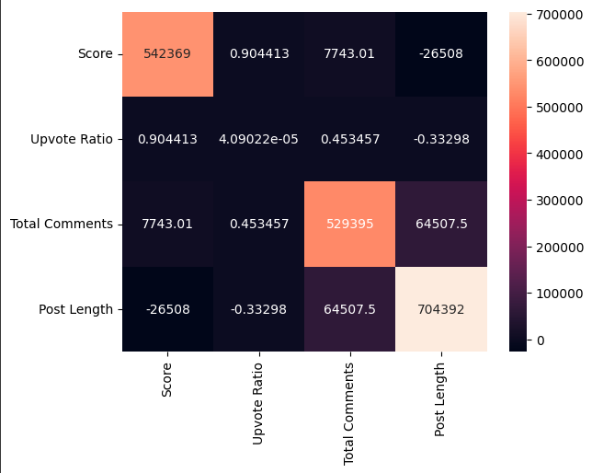
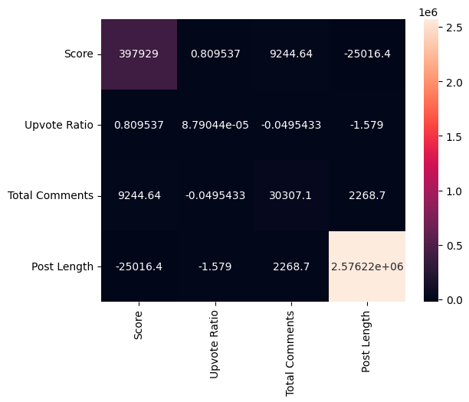
Statistical Relationships in
Pilot Data
Temporal Precedence:
COVID precede the change in post trends: Earliest post is from 2018, newest post is from 2022
There is an increase in post length and number of post interactions (upvote ratios and comments)
Covariance of Cause and Effect: shift of post trends linked to COVID
Pre-COVID Post-COVID

Slide 25
Correlational Method
Correlation bivariate normal model using Pearson’s R
Continuously normal distribution
Log transformation for variables
Assume a linear relationship between upvote ratio, score and total comments
Post length & num of comments - positive correlation
Future plan: Correlation between probability of topics and post engagements → Pearson and Spearman

Slide 26
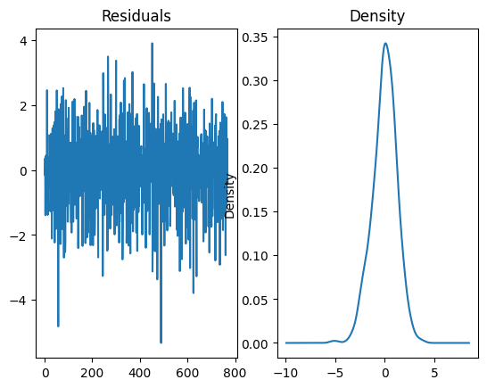
Central Tendency and Dispersion
Sample: Pre-COVID and Post-COVID Dataset from Depression subreddit
Log transformation for normal distribution
Notes:
take log transformation for depression subreddit data: vertically spread around the 0 -> linear relationshhip
density -> normally distributed

Slide 27
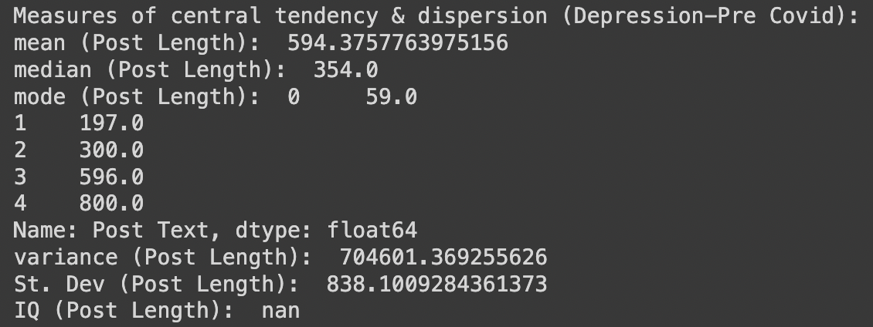
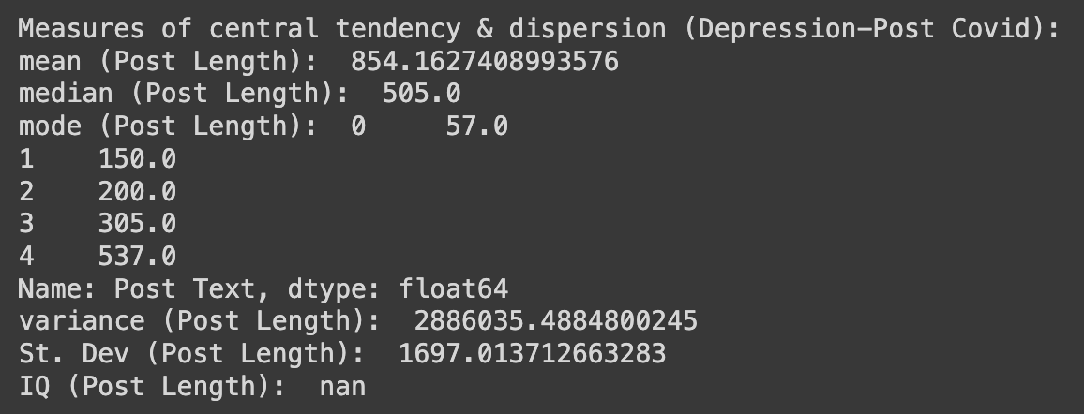
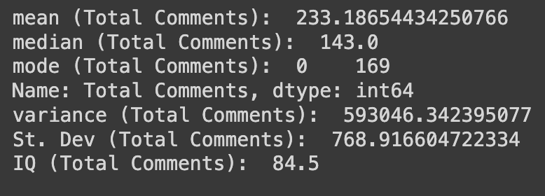
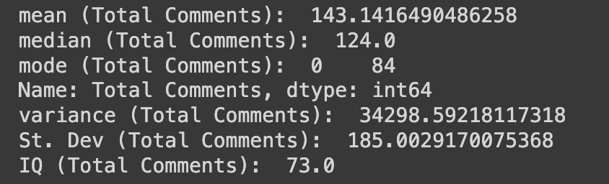
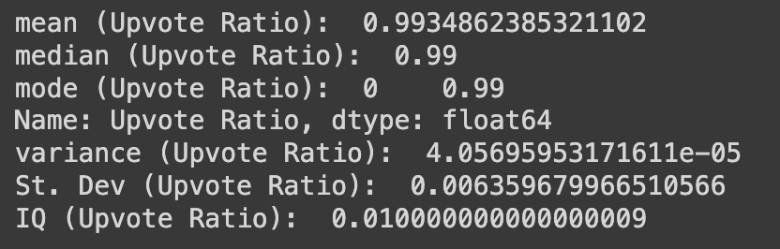
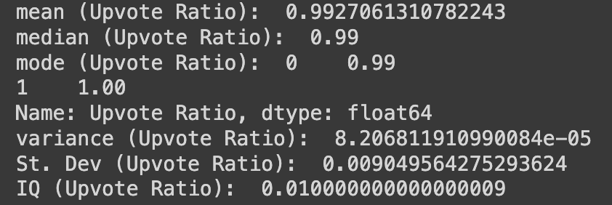
Central Tendency and Dispersion
Sample: Pre-COVID and Post-COVID Dataset from Depression subreddit
Pre-COVID Post-COVID
Notes:
we're mainly using these variables for the rest of our project, but we're also looking into incorporating other variables to make up a more concrete number of engagements outcome

Slide 28
Threats to Internal Validity
Threats to Internal Validity | Susceptible or not
History Confound Personal situations, historical events, societal changes, or policy shifts that occur concurrently with COVID | Susceptible Unless there are efforts to control other major events that can impact mental health trends
Instrumentation Confound Reddit top posts algorithm changed over time | Susceptible Collecting with Reddit API for using same algorithm for two time intervals

Slide 29
Threats to Internal Validity
Threats to Internal Validity | Susceptible or not
Maturation Involves users’ natural change in behavior and maturity over time not due to COVID | Susceptible Mental health can be influenced by various factors; cannot be controlled
Experimental Mortality People with mental disorders might stop posting on social media | Susceptible People might drop out of the sample–esp. suicideWatch
Statistical regression People with severe depression might post more | Susceptible Impact the generalization of findings

Slide 30
Plausible Threats
Susceptible Threat | Plausible
History Confound | Yes, as there can be other historical events, personal situations and outside factors that could potentially influence mental health-related subreddits
Instrumentation Confound | Yes, changes in measurement tools or methods used to analyze trends could introduce biases or inconsistencies
Maturation Confound | Yes, since individuals’ mental health can be influenced by various factors as they age
Experimental Mortality | Yes, people might drop out of the samples by various factors
Statistical Regression | Yes, selection might be biased since sample is not generalized

Slide 31
Ruling Out Plausible Threats
Maturation: Using Time Series design
Instrumental Confound:
Ensure instrument validity
Establish instrument reliability
Mitigate measurement biases
Statistical Regression:
Assess model fit and residuals
Control for relevant covariates
Assess collinearity
Notes:
Ensure instrument validity: Make sure data collection and cleaning processes are valid, all methods align with the research objectives and are appropriate for capturing the trends in subreddits
Establish instrument reliability: Test the reliability of measurement tools by using established reliability measures such as inter-rater reliability to ensure that the instrumentation provides consistent measurements over time
Mitigate measurement biases: Use statistical technique to normalize data to account for variations and control for the influence of score on the analysis; Randomly sample posts to ensure a representative dataset
Assess model fit and residuals: Evaluate the model fit and residuals to ensure that the statistical model captures the relationship between the variables. Assess the goodness of fit measures to see if the model explains the variance in the outcome variable. Additionally, examine the residuals to check for any systematic patterns or outliers that may indicate model misspecification.
Control for relevant covariates:Covariates are additional variables that may independently influence both the predictor variable (COVID) and the outcome variable (subreddit usage trends). For example, demographic factors, such as age, gender, or geographic location, may be associated with both COVID-related impacts and subreddit usage trends
Check collinearity: Collinearity occurs when two or more independent variables are highly correlated, making it difficult to determine their individual effects on the outcome variable

Slide 32
Plausible Threats
Unable to Address
History confound: changes in participants' mental health or posting behavior over time due to maturation or other external historical factors could still confound the observed effects
While the post-intervention assessment can capture changes, it may be challenging to attribute those changes solely to the intervention.
To address in the future: Experimental Mortality
Sensitivity Analysis: Assess and compare impacts
Consider data imputation methods

Slide 33
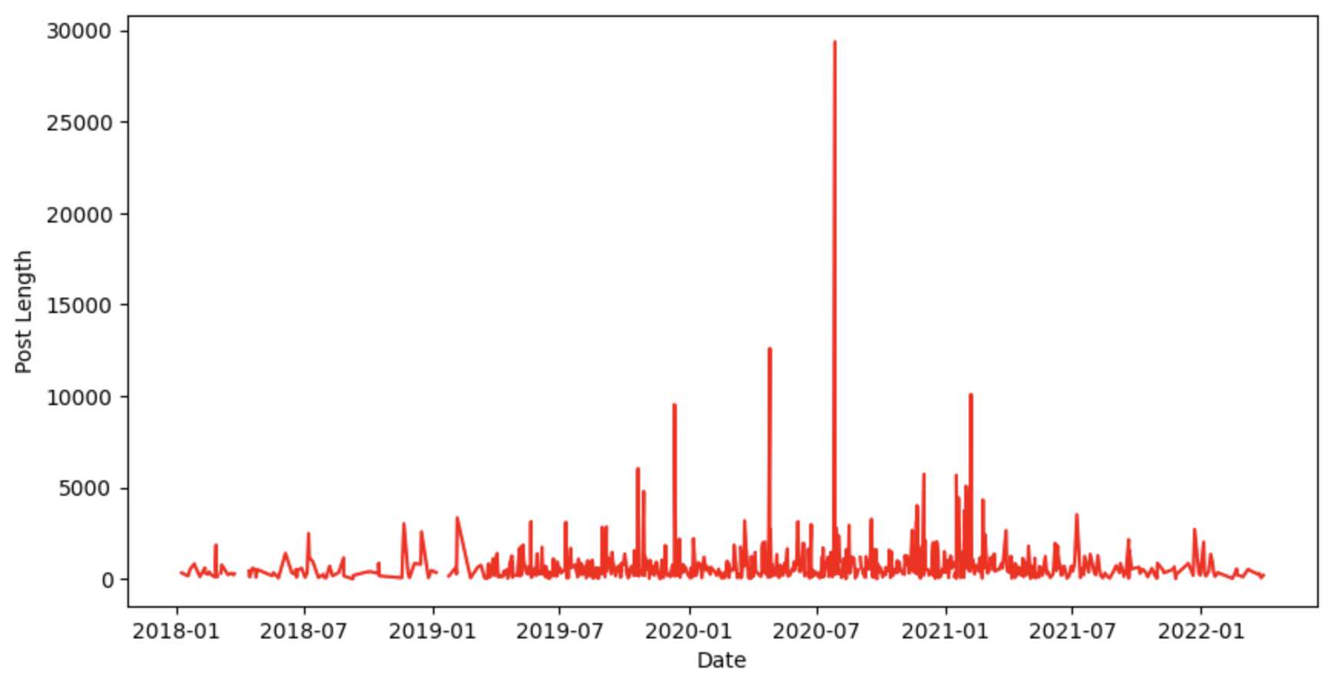
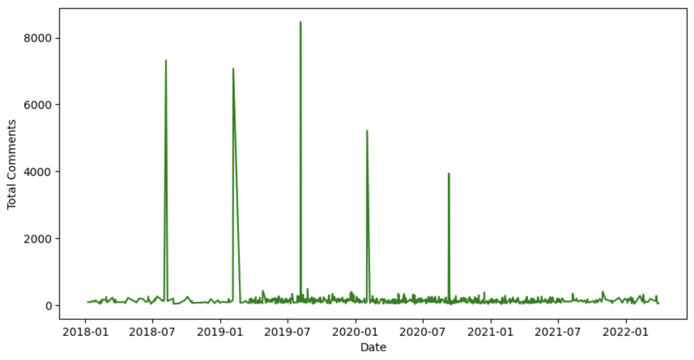
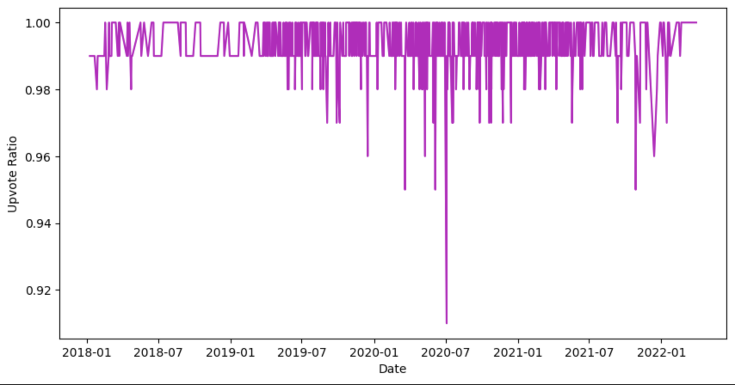
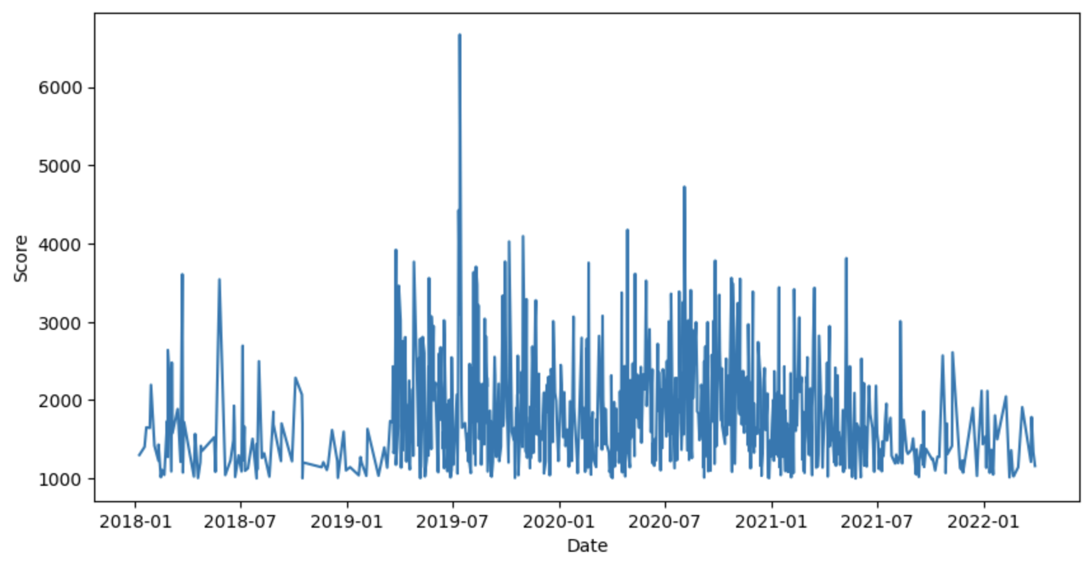
Descriptive Statistics in Pilot Data
(Examples Depression subreddit Time Series)
Notes:
Post length increased after covid, hitting an all time high after covid
upvote ratio peak all time low in 2020 after covid

Slide 34
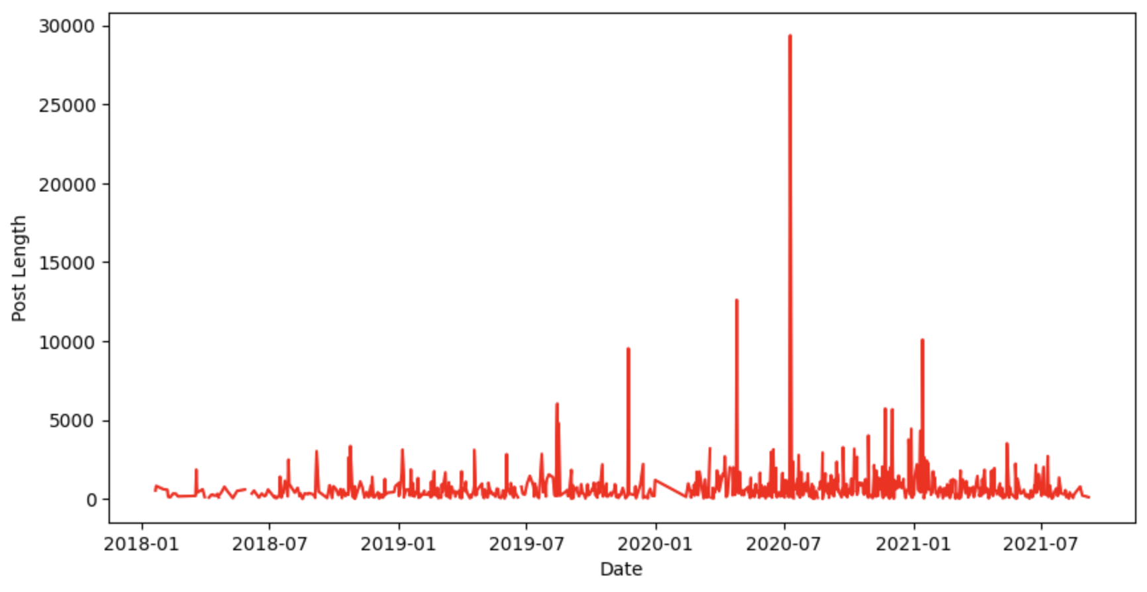
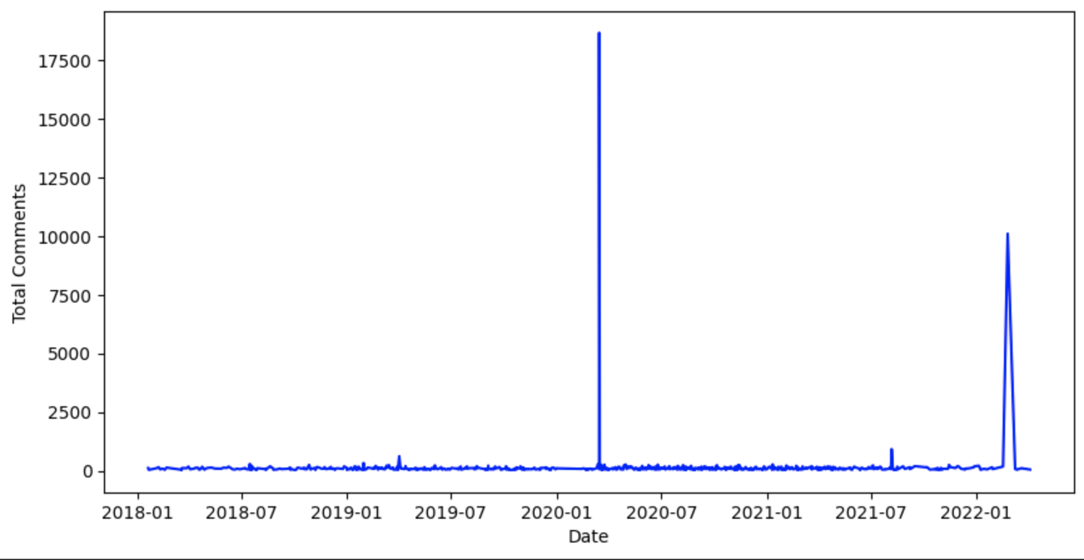
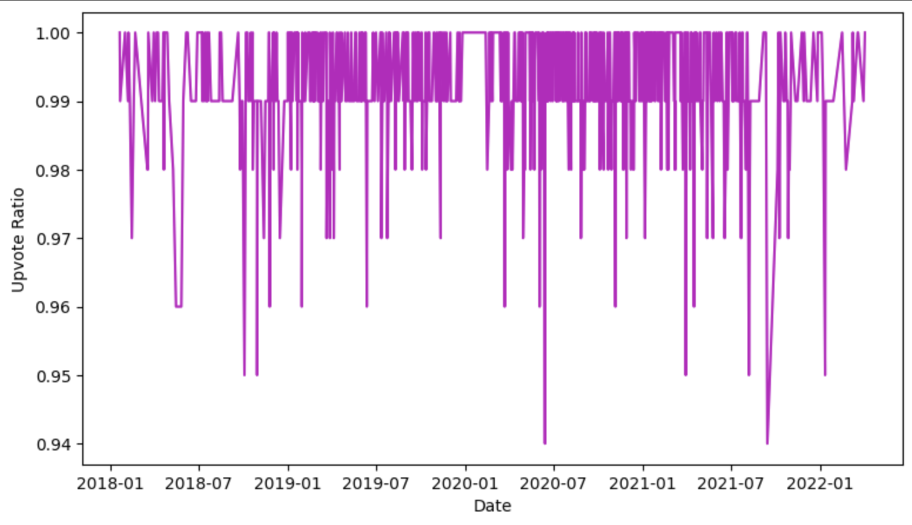
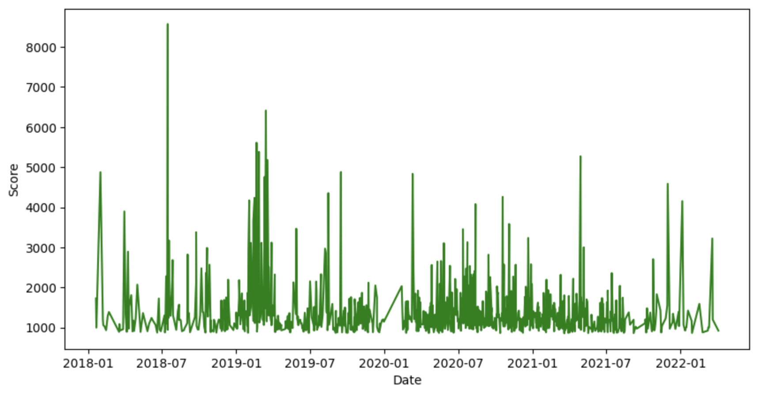
Descriptive Statistics in Pilot Data
(Example from Anxiety subreddit Time Series)
Notes:
Post length increased after covid
upvote ratio peak all low in after covid

Slide 35
Experimental Design
Quasi-experimental design
Post Trends
Post Trends
Subreddit
COVID
Post engagements
Post engagements
Nonequivalent Control groups
Pre-COVID
Post-COVID
-> Replicate for compare 9 different subreddit groups

Slide 36
Quasi-Experimental Design
Nonequivalent control groups design
Compare 9 different mental health-related subreddits
Time Series Analysis - ARIMA Prediction
Several observations for time series:
Post Trends
Engagement
Mitigate maturation confound

Slide 37
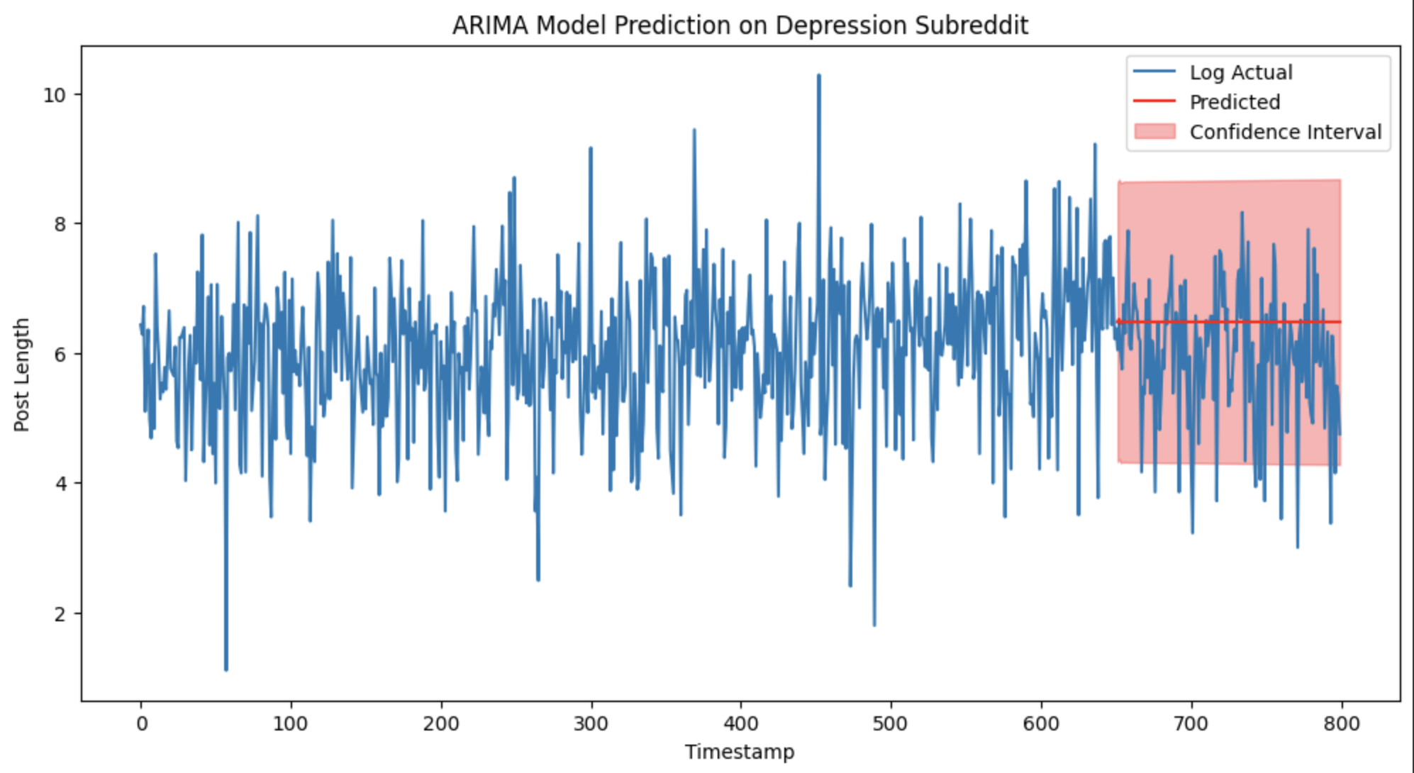
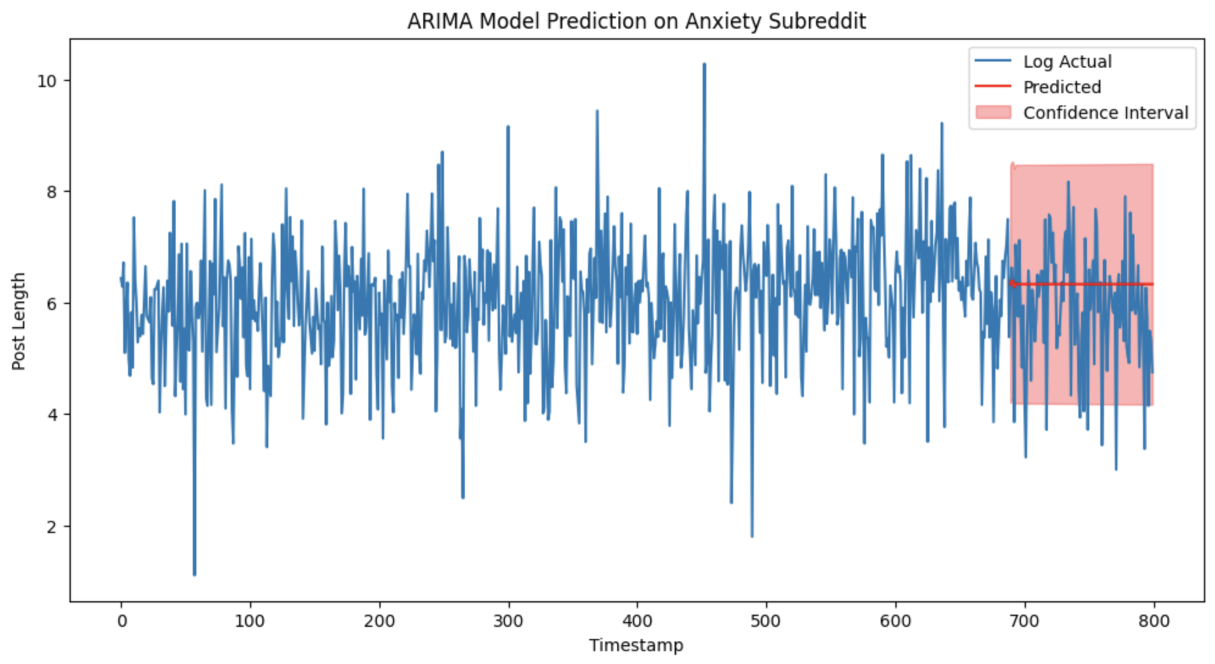
ARIMA Model Analysis
Observations:
Post content
Post text
Post length
Engagement
Total comments
Upvote ratio
Score
X (treatment): COVID (determined by time)
Notes:
general arima model analysis with post length
forecasting prediction line with 95% confidence interval shows post length slightly increased than pre covid

Slide 38
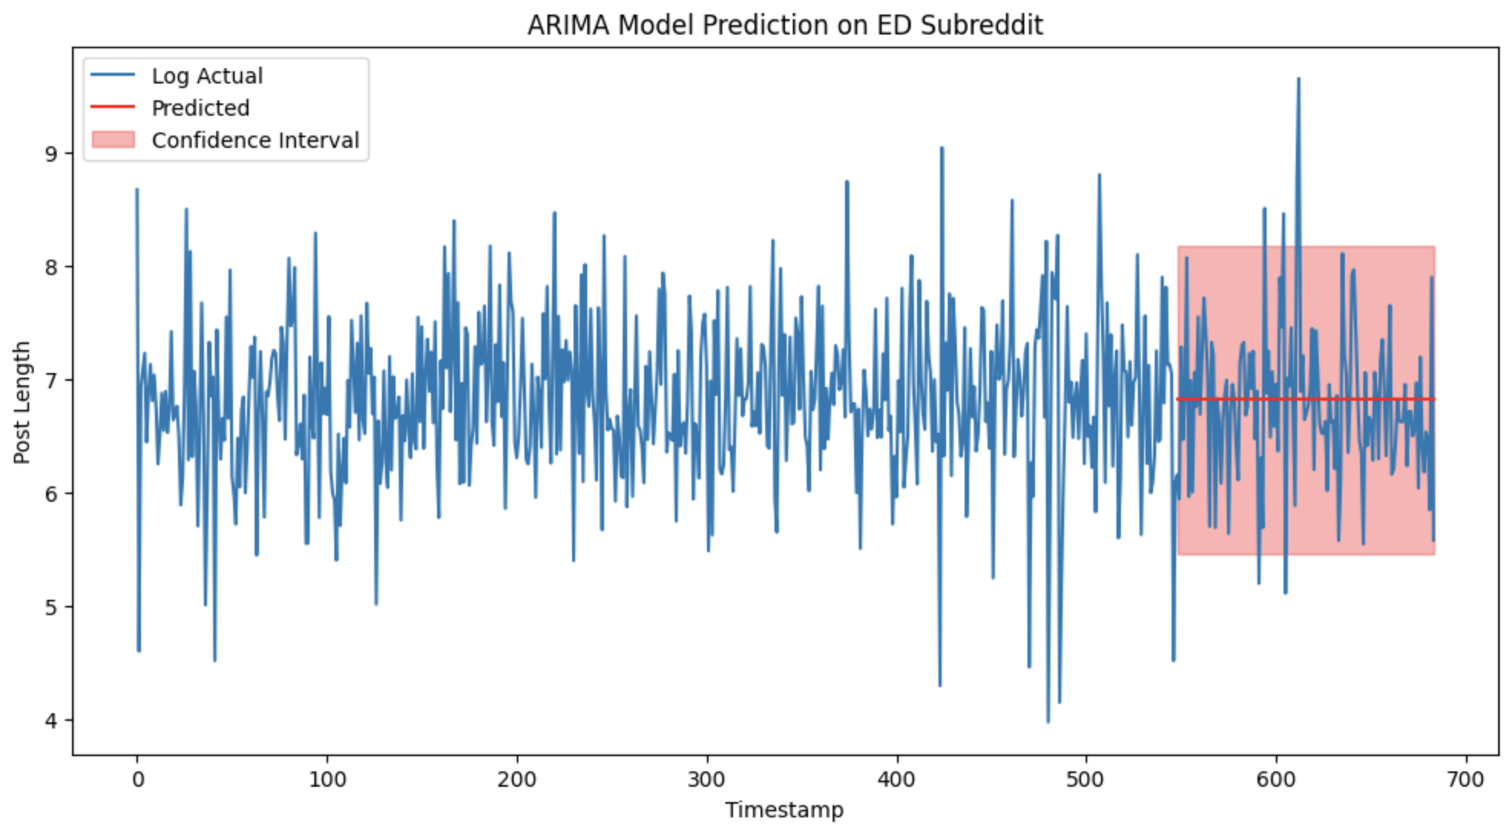
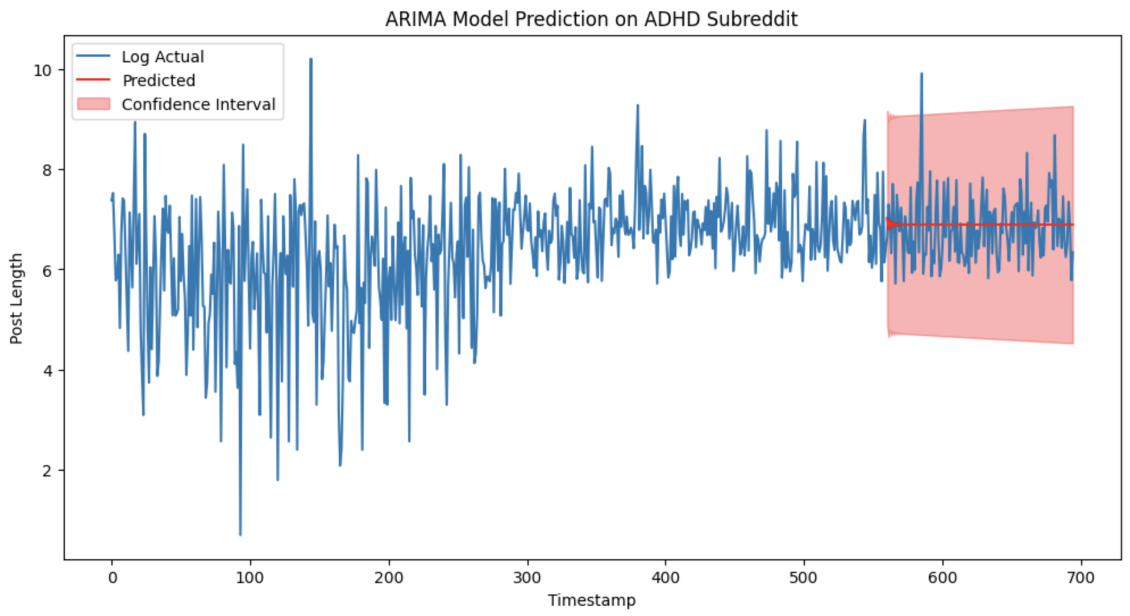
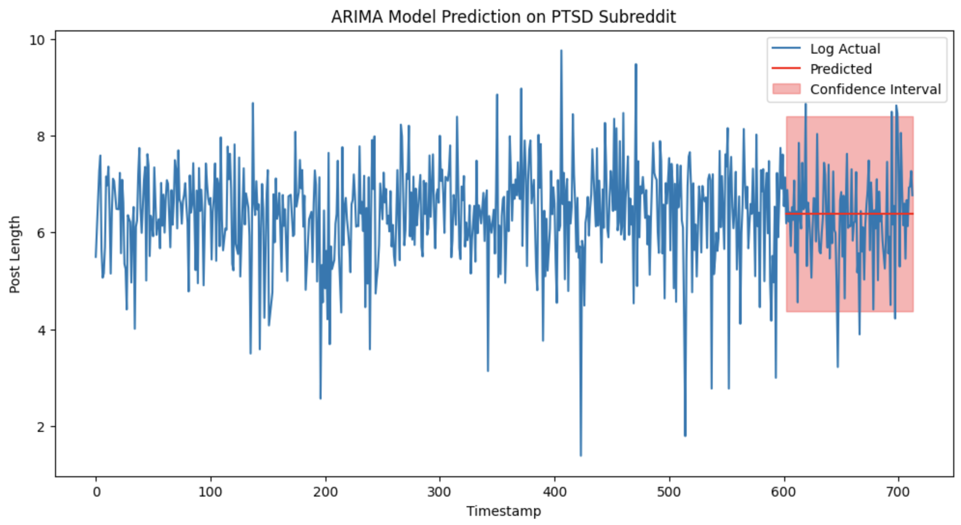
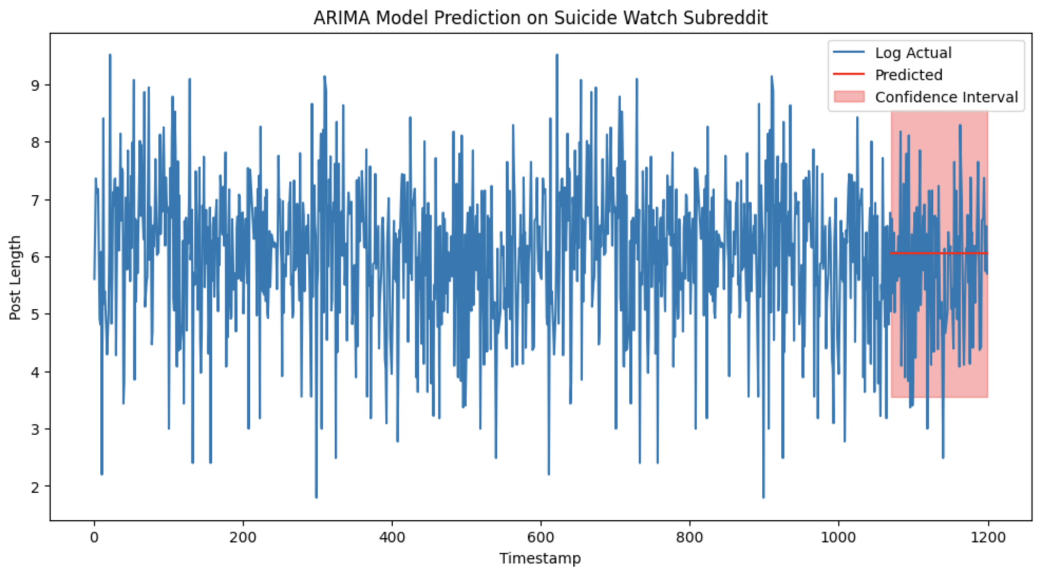
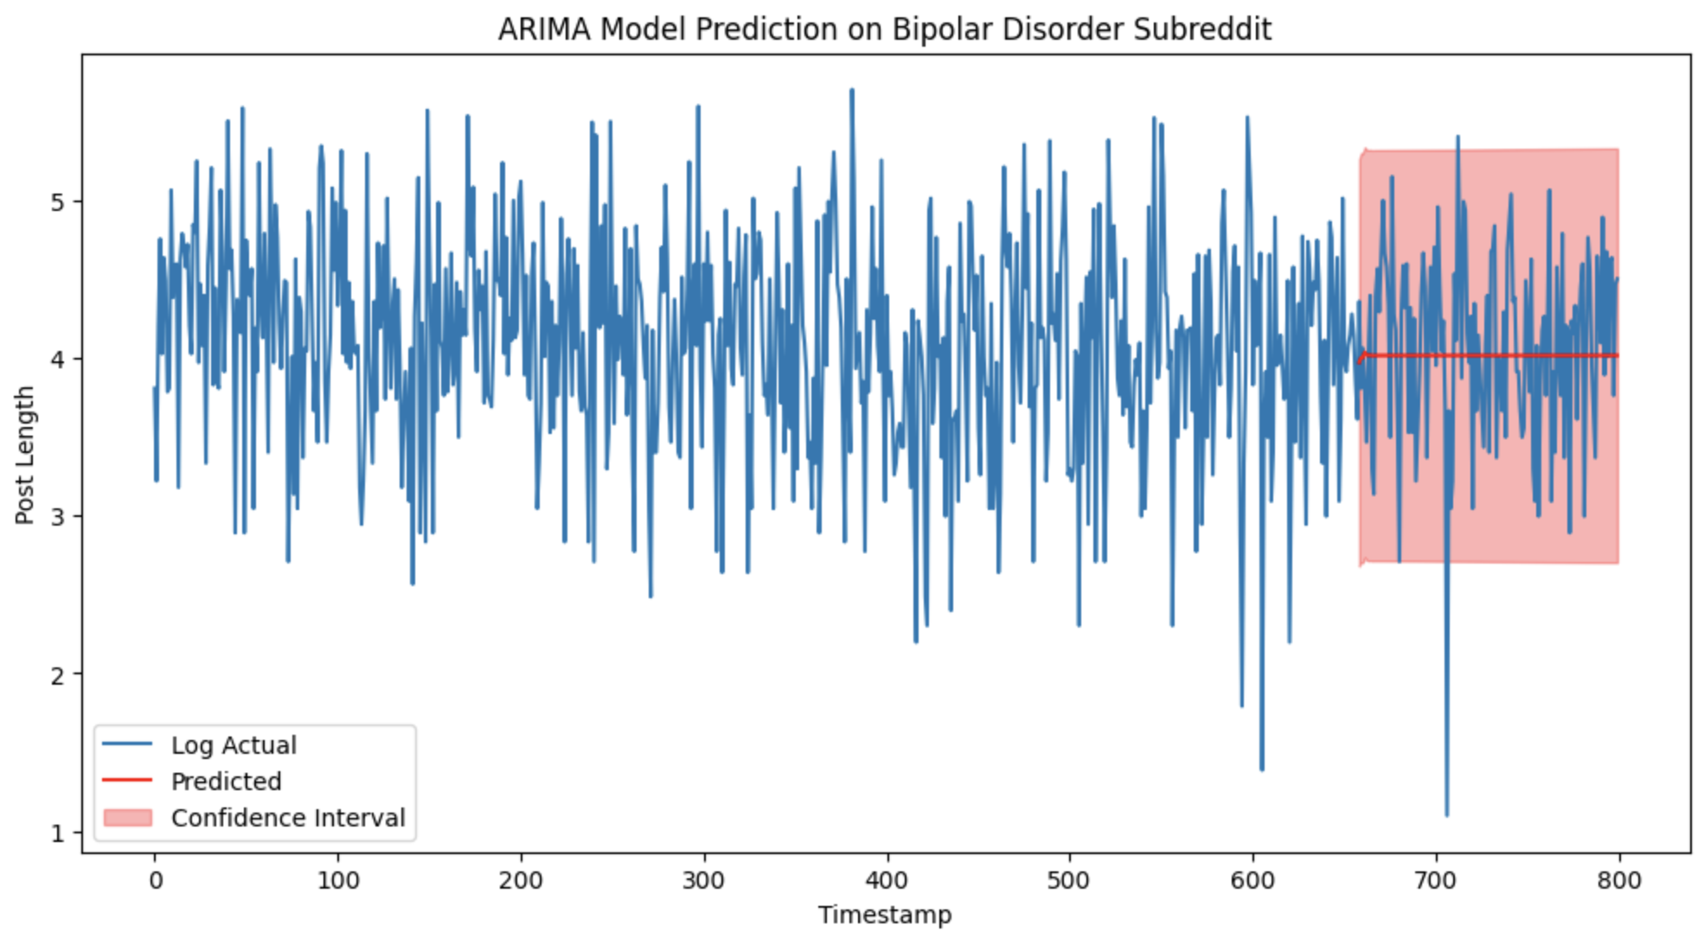
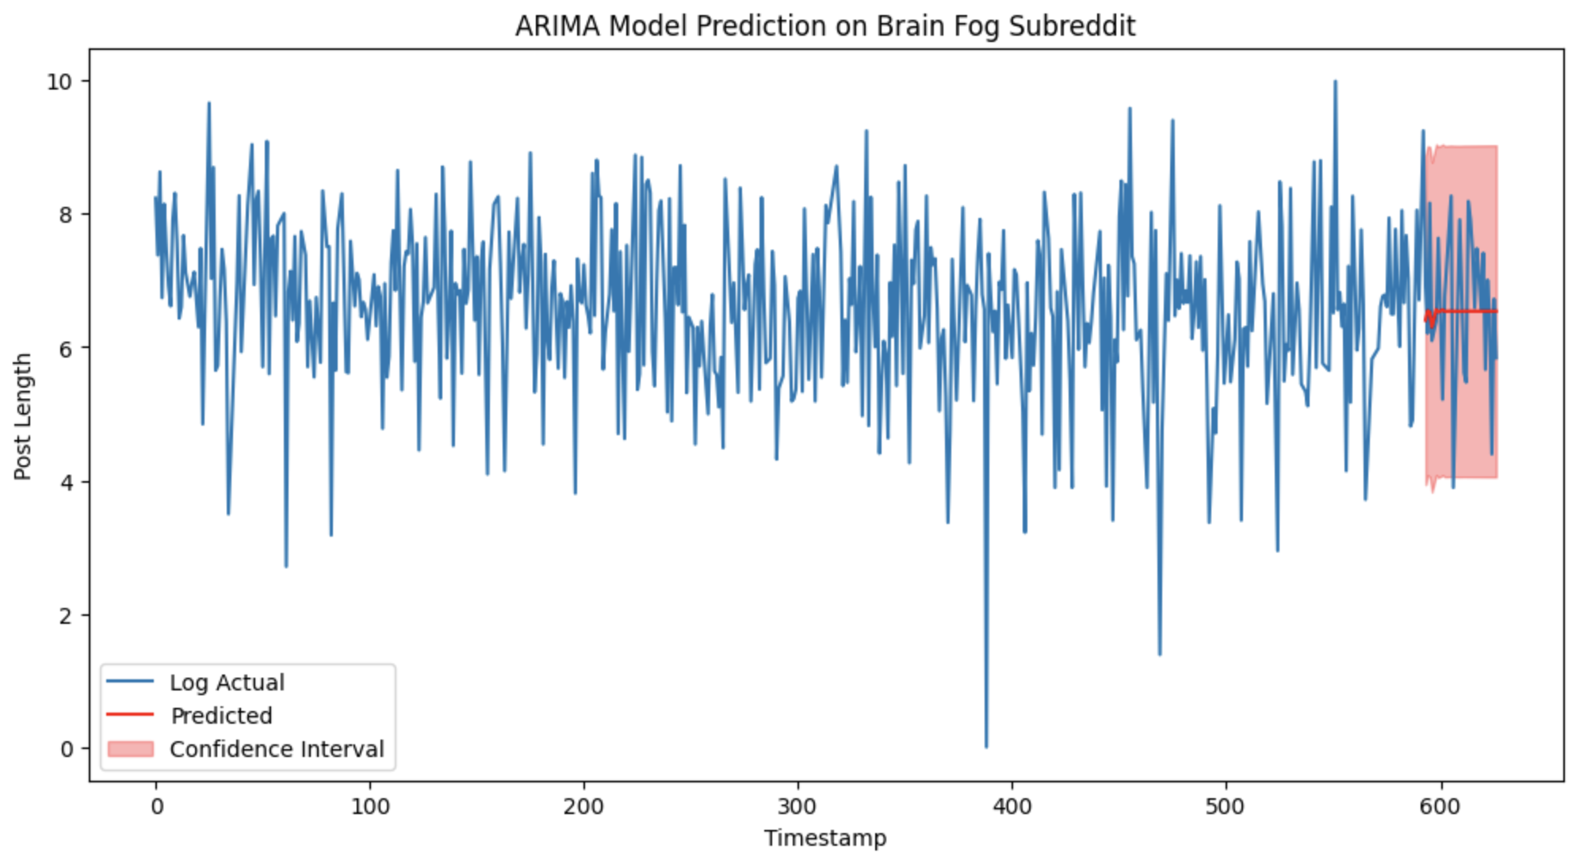
ARIMA Model Analysis

Slide 39
Independent/Dependent Variables
Independent variables: Post Text, Total Comments, Score, Upvote Ratio
Dependent variables: Post Length and Engagements
Relationship: Causal relationship between independent variables and each dependent variables

Slide 40
Statistical/ML Analysis
Statistical Analysis:
ARIMA: time series analysis
ANOVA: Comparison of mean of features from 9 different subreddits
ML Analysis:
Topic modeling: post text analysis

Slide 41
Analysis/Type 1 error
Nonequivalent group analysis
ARIMA time series : type 1 error rate 0.05
Adjusted with Bonferroni correction
ANOVA: type 1 error rate 0.05
Adjusted with Bonferroni correction
Notes:
to control multiple comparison

Slide 42
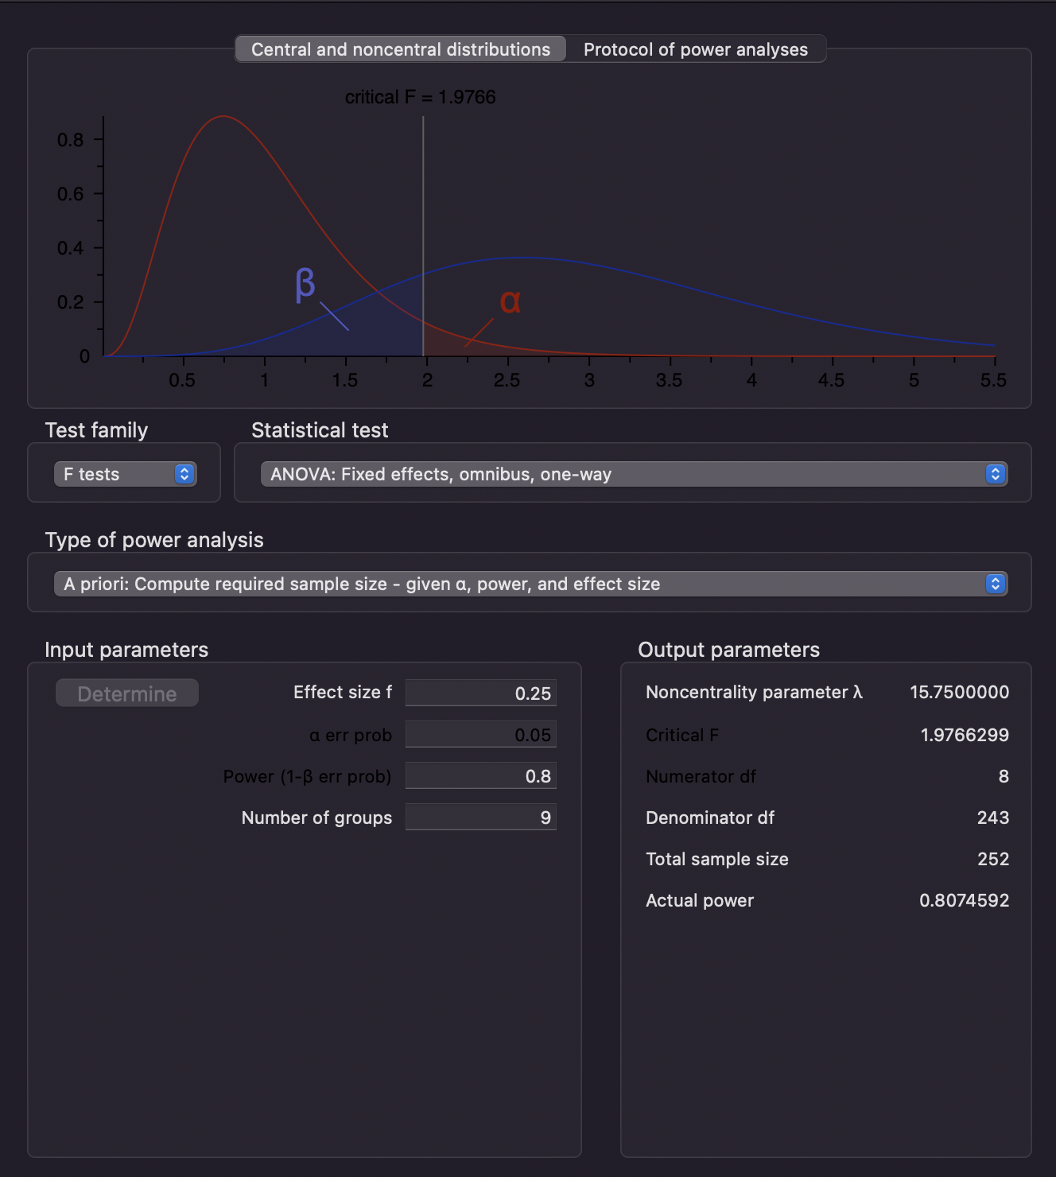
ANOVA
Effect size 0.25
error: 0.05
power : 0.8
Num of groups: 9
Total sample size: 252
Notes:
to control multiple comparison

Slide 43
Covariates
Covariates
User demographic
Socioeconomic factors
Pre-existing mental health conditions
External factors
Time variables
Only controls time variables
Using ANOVA
Notes:
the only covariate we can control is time variables

Slide 44
Project Summary
Research Question: Does COVID affect post trends and post engagement from mental illness related subreddits?
Sampling Plan:
Purposive Sampling: datasets from 9 mental health-related subreddits
Cluster Random Sampling: Uniform data from 2018 to 2020 and 2020 to 2022
Measurement Strategy:
Collect monthly data directly from reddits and use Python to transform necessary data
Analyze features according to their data types and units of analysis
Ensure that the data collection and cleaning processes are accurate
Ensure that all measurements adhere to ethical guidelines and regulations
ML/Statistical methods: ARIMA time series , ANOVA comparing means of 9 groups

Slide 45
Project Summary
Internal validity:
History confound: external situations that occur concurrently with COVID
Instrumentation confound: top posts algorithm changed over time
Maturation: involves natural changes of users
Experimental mortality: users drop out of the sample
Statistical regression
External validity:
Units: not representative of population
Place: collected by only one social media platform
Time: limited to 2 years of pre and post COVID
Future direction:
Collect more data from other subreddits (both mental health-related and other subreddits) to observe the trend in posts
Search for a more powerful tool to scrape total number of posts -> more trend analysis
Perform topic modelling on data to monitor change in topics in addition to post length

